Slide 1

Code-Bros
Students use multiple learning sources but cannot integrate them into structured study plans.

Slide 2


Project Aether: AI-Powered Learning Revolution
Project Aether transforms traditional learning materials into engaging, interactive experiences using cutting-edge AI. Leveraging Google Gemini, our platform converts passive content into dynamic tools for enhanced understanding and retention.

Slide 3
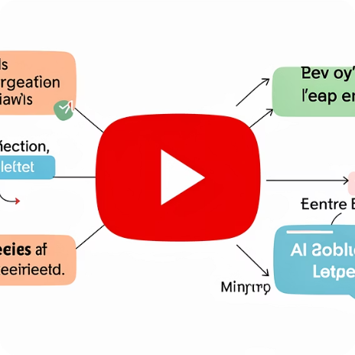
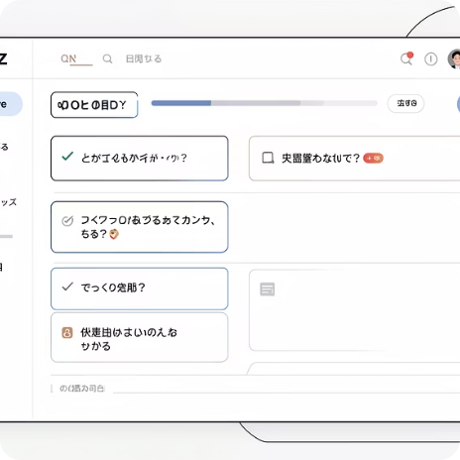
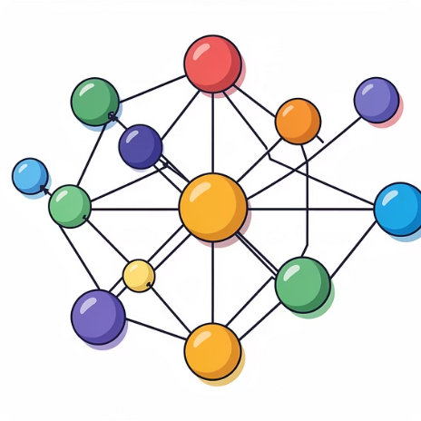
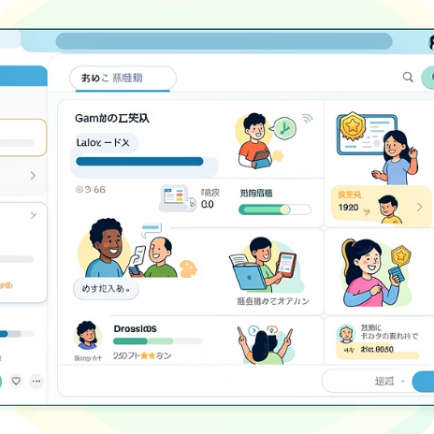
Key Features: Unlocking Knowledge Potential
AI Summaries
Dynamic Quizzes
3D Knowledge Graphs
Gamified Learning
Condense lengthy YouTube lectures and complex PDFs into digestible, key-point summaries.
Generate custom quizzes from any content to test comprehension and reinforce learning.
Engage users with interactive challenges, rewards, and progress tracking for motivation.
Visualize intricate relationships between topics for a deeper, more intuitive understanding.

Slide 4
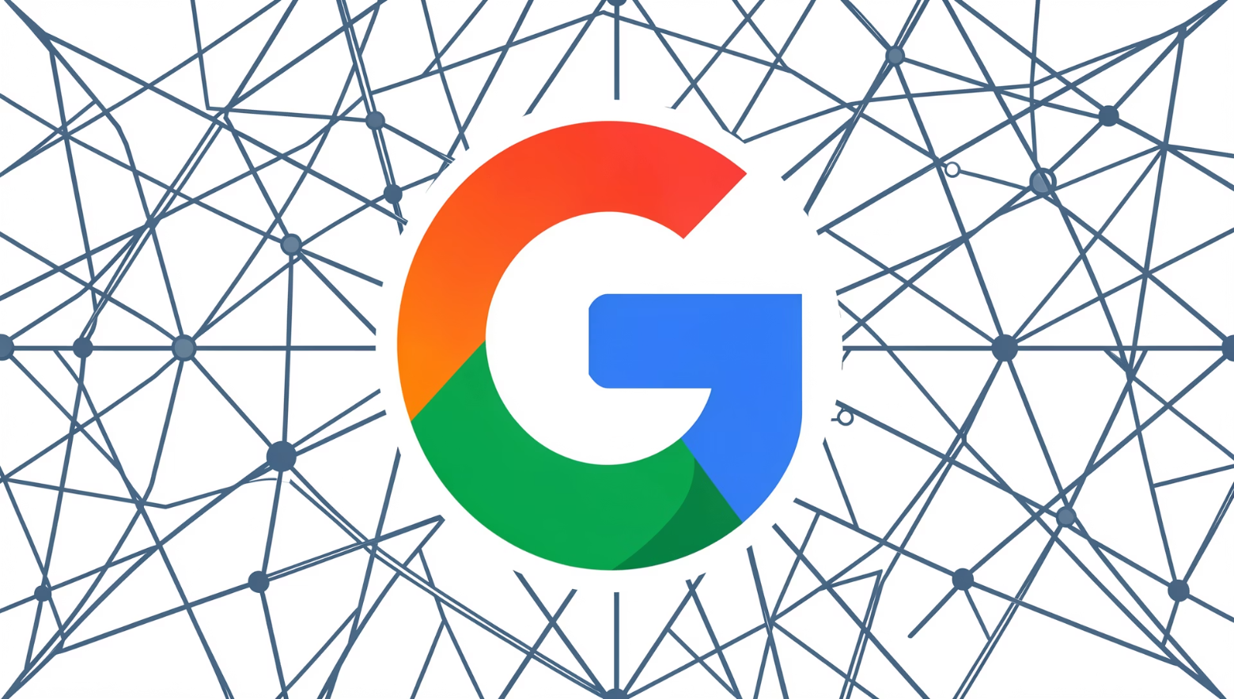
Tech Stack: Powering Intelligent Learning
Google Gemini AI
Core for natural language processing, summarization, question generation, and graph creation.
Next.js & React
Robust and scalable frontend for a dynamic, responsive user interface.
Node.js Backend
Efficient server-side logic, API handling, and content processing.
MongoDB Atlas
Flexible NoSQL database for content storage, user data, and knowledge graphs.

Slide 5
Implementation Steps: From Concept to Reality
01
02
03
Content Ingestion
Gemini AI Integration
Data Structuring & Storage
Develop modules for secure YouTube link parsing and PDF upload/OCR. Integrate with Google Cloud Storage.
Implement API calls for text extraction, summarization, quiz generation, and knowledge graph data parsing.
Design database schemas for storing processed content, user progress, and knowledge graph nodes/edges.
04
05
Frontend Development
Gamification Layer
Build interactive UI components for displaying summaries, quizzes, and a 3D graph visualization library.
Integrate user profiles, progress tracking, achievements, and leaderboard features.

Slide 6
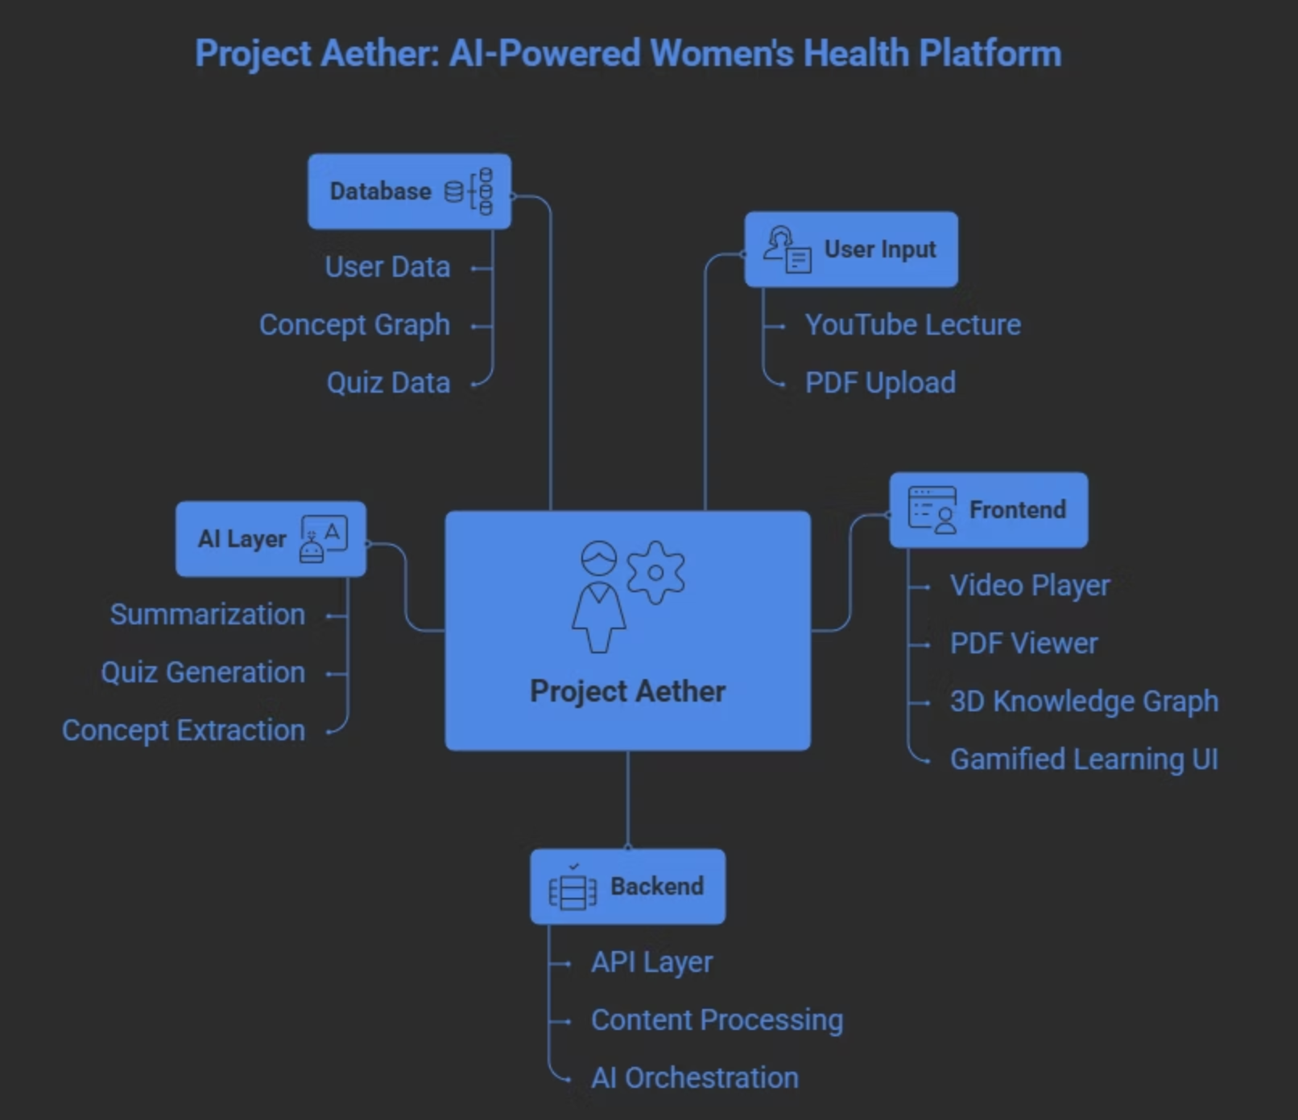

Slide 7
Relevant links here.
Github: https://github.com/riturajjhaba938/Aether.git
Fill Form:
Hosted project link https://aether-five-tau.vercel.app/
YT Video Explain https://youtu.be/TULmlNcDTJQ?si=wv5U6qVbob_5tVL5
Thank you

